Slide 1

Williams International Digital Transformation
Building an Internal Data Platform

Slide 2
Agenda
Organization/Industry Description
Current State of Resources
Problem Description/Research Question
Method
Deliverables/Findings
Research Evaluation
Lessons Learned
Future Work and Conclusion

Slide 3
Organization/Industry Description
Competitive Aerospace industry with global giants like: Pratt & Whitney, Rolls-Royce, and GE Aerospace
Williams International needs to bridge the gap between itself and its larger competitors
Company | 2023 Revenue | Estimated Number of Employees
Pratt & Whitney | ~$23.7 billion | ~43,000
Rolls-Royce | ~$16.67 billion | ~50,000
GE Aerospace | ~$26 billion | ~52,000
Williams International | Not publicly disclosed | ~1,000
Notes:
No business is in the business of not making more money

Slide 4
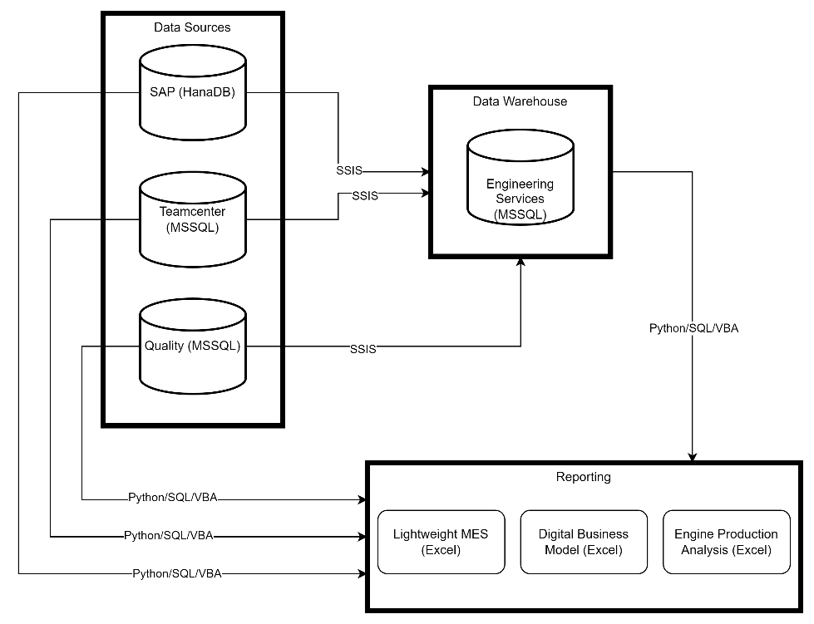
Current State
All reporting is done directly on production databases using Python, SQL, and VBA
Data is seldomly pulled into a data warehouse
Data warehouse is less than live being updated only once per day at most by IT

Slide 5
Problem Description
How can Williams International design an integrated data platform that can handle unstructured, semi-structured, and structured data?
Remove siloed data sources
Handle complex and modern data types
Migrate legacy data trapped in unstructured formats
Enforce data governance and quality
Make integration and interoperability a first-class feature

Slide 6
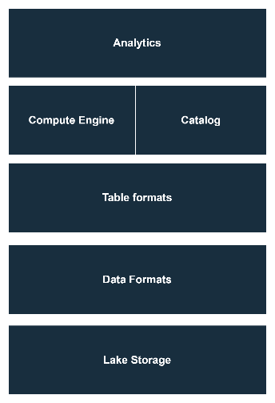
Method: What is a Data Lake?
A Data Lake is a centralized storage system that holds raw data from various sources in its native format; structured (RDBMS), semi-structured (JSON), and unstructured (images or videos).
As Williams International works towards implementing a Data Lake, it should integrate what already exists from the data warehouse. The main point of the Data Lake is the ability to ingest more data from more sources.
(Amazon Web Services, n.d.).
Notes:
No business is in the business of not making more money

Slide 7
Method: Why Not Extend the current Implementation?
Is the organization generating or receiving data beyond the structured formats typically stored in a data warehouse?
The current data warehousing scheme exclusively implements SQL Server. As a RDBMS, SQL Server is not fit to handle modern and complex data types (JSON, XML, binary files, etc).
As Williams International branches out into more web-based communication using protocols such as REST, they need to extend data storage capabilities to handle this.
Does the organization struggle with siloed data across systems?
Williams International deeply struggles with mission critical reporting being siloed inside of an excel spreadsheet. Directors of business units are forced to wait more than 30 minutes for their reports to update.
A Data Lake, implemented correctly, aims to address this issue by serving as the central repository for production data, eliminating redundancy and silos.
Notes:
No business is in the business of not making more money

Slide 8
Deliverables and Findings: Part 1 of 4
Business Requirements
Functional Requirements
Comply with ITAR regulations
Provide a cost-benefit justification aligned with business goals
Address current and future data demands effectively
Support unstructured, semi-structured, and structured sources
Enable data governance and quality assurance processes
Integrate mission-critical systems to eliminate data silos
Facilitate real-time and historical data processing for analytics

Slide 9
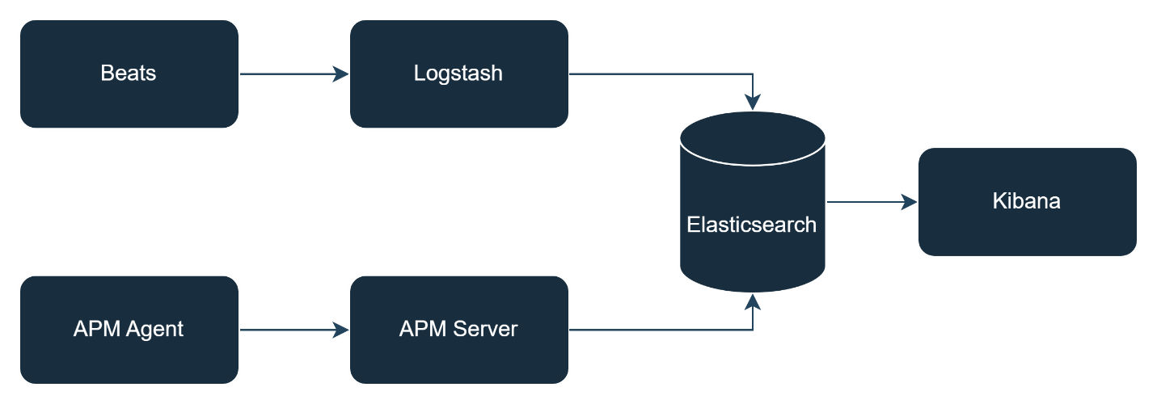
Deliverables and Findings: Part 2 of 4
Solution 1: Elastic On-Premises Data Platform
Beats consume various data (files and metrics)
Application Performance Monitoring (APM) for software applications
Logstash aggregates beats data sinking into Elasticsearch
APM aggregates all application data sinking into Elasticsearch
Elasticsearch provides full text search capabilities through http and multiple clients
Kibana is a visualization tool that streams live data from Elasticsearch

Slide 10
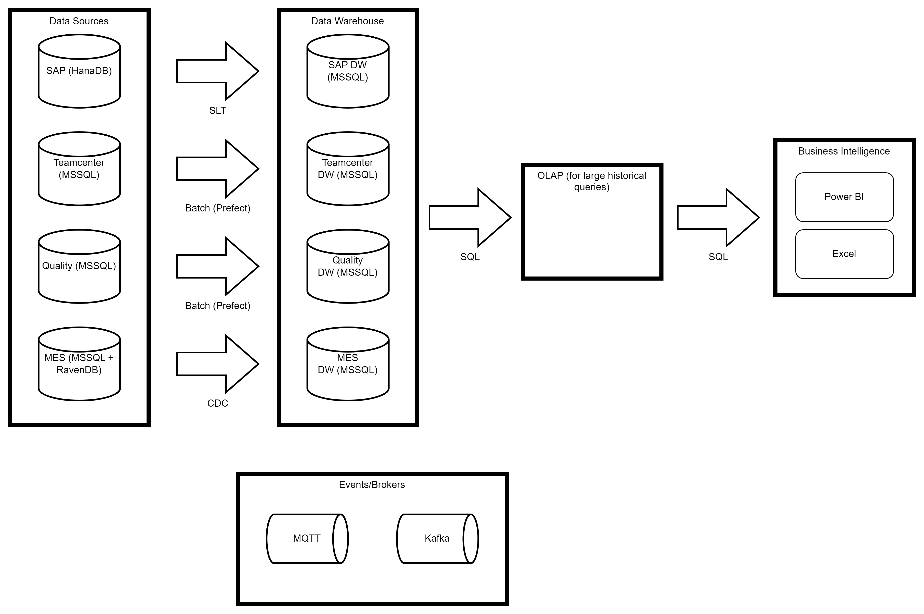
Deliverables and Findings: Part 3 of 4
Solution 2: Custom On-Premises Data Platform
Broadcast changes in data sources
Data warehouses update live with changes
Large queries happen in tools meant for analysis
Business intelligence is done is tools more apt for the job
Orchestrated by event brokers

Slide 11
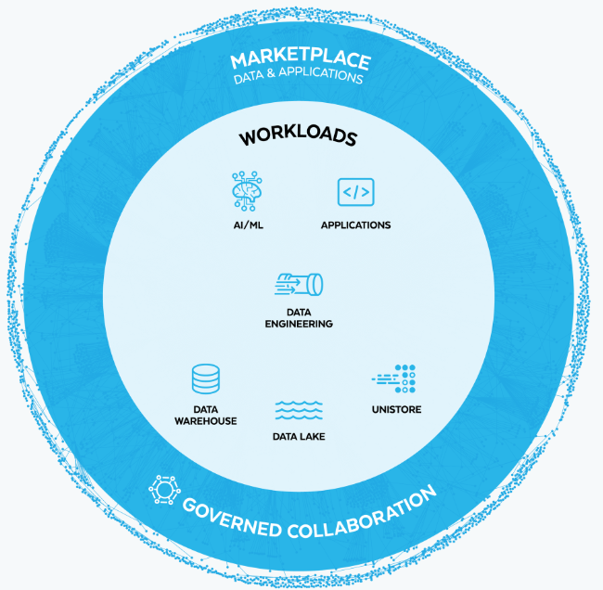
Deliverables and Findings: Part 4 of 4
Solution 3: Snowflake Cloud Data Platform
One platform to rule them all
ETL vs ELT
Time travel
Snowpark (embedded python functions)

Slide 12
Research Evaluation: Part 1 of 3
Stuck using Elastic stack as it’s not overly integrate-able with other existing tooling
Would only ever use about 10% of Snowflake’s capabilities
Custom On-Premises Data Platform
Exploration and customization of a specific data platform
Notes:
No business is in the business of not making more money

Slide 13
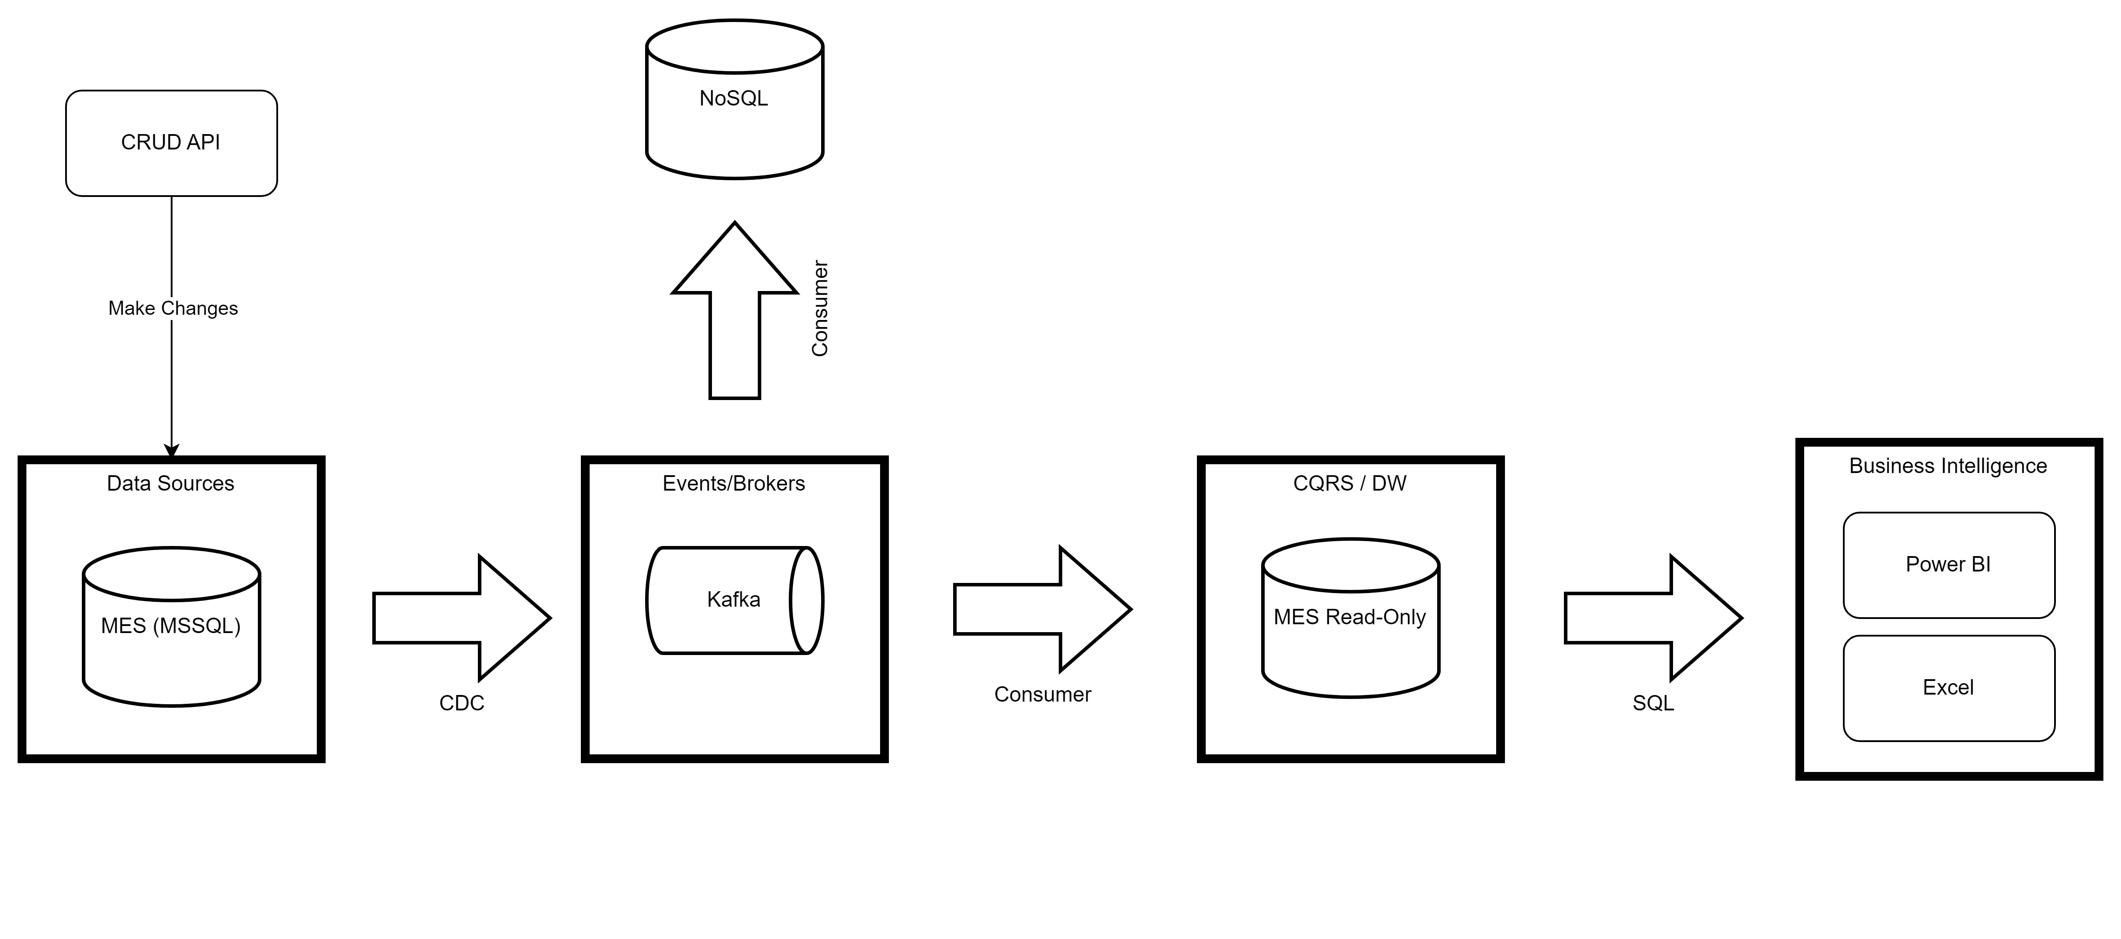
Research Evaluation: Part 2 of 3
Notes:
No business is in the business of not making more money
API -> SQL Server -> Kafka (UI & Docker) -> RavenDB -> DW -> PowerBI

Slide 14
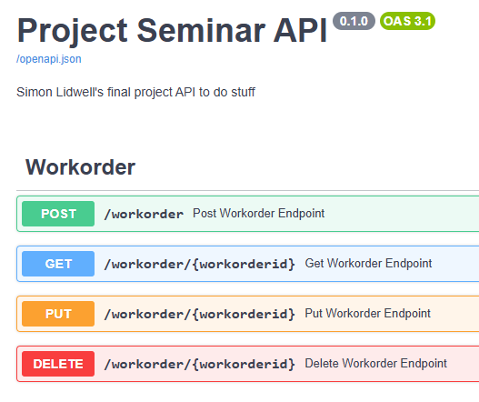
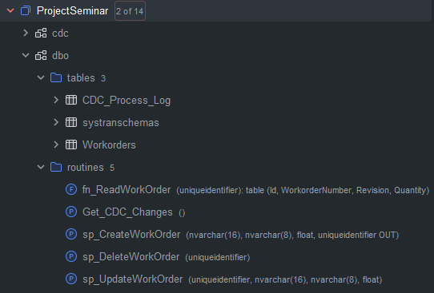
Research Evaluation: Part 3 of 6
Notes:
No business is in the business of not making more money

Slide 15
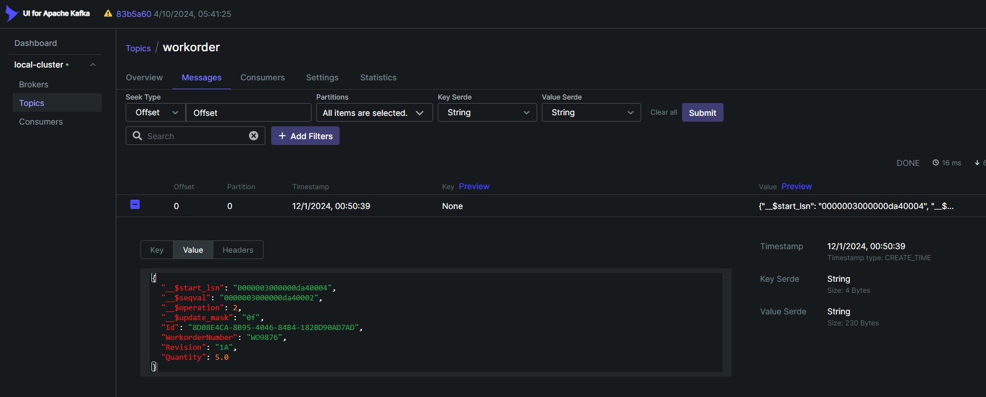
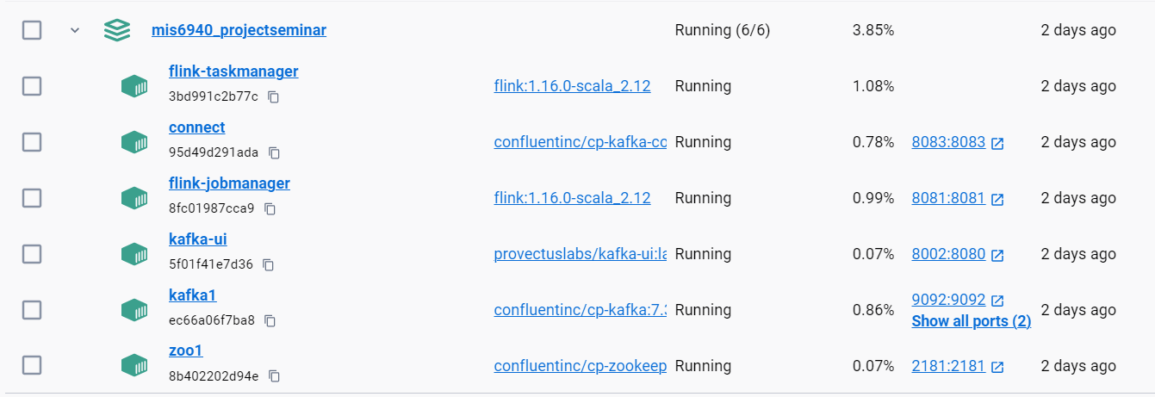
Research Evaluation: Part 4 of 6
Notes:
No business is in the business of not making more money

Slide 16
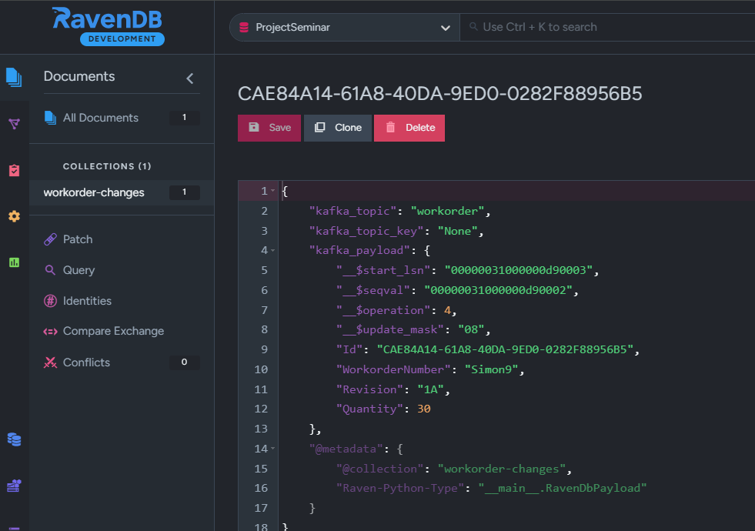
Research Evaluation: Part 5 of 6
Notes:
No business is in the business of not making more money

Slide 17
Research Evaluation: Part 3 of 3
Notes:
No business is in the business of not making more money

Slide 18
LESSONS Learned
The Data Lake is a concept, not just the implementation of one new piece of technology
Buy-in comes from the top down
This project is bigger than one person
Other companies are experiencing the same issues

Slide 19
Future Work and Conclusion
Limitations
Lack of knowledge
Technology is rapidly changing
Time
Money
Future Work
Implement broadcasting changes pattern for live data replication
Reconsider ITAR and Cloud native platforms
Assemble dedicated data engineering team

Slide 20

Thank You
slidwell@oakland.edu

Slide 21
References
Pratt & Whitney. (n.d.). About Pratt & Whitney. Retrieved November 16, 2024, from https://www.prattwhitney.com/en/our-company/about
Rolls-Royce Careers. (n.d.). Our Locations. Retrieved November 16, 2024, from https://careers.rolls-royce.com/usa/our-locations/rest-of-the-world/
GE Aerospace. (2024). GE Aerospace to hire more than 900 engineers this year. Retrieved November 16, 2024, from https://www.geaerospace.com/news/press-releases/ge-aerospace-hire-more-900-engineers-year
GE Aerospace. (2024). GE releases its 4Q23 full-year 2023 results and 2024 guidance. Retrieved November 16, 2024, from https://www.geaerospace.com/news/articles/performance/ge-releases-its-4q23-full-year-2023-results-and-2024-guidance
Amazon Web Services. (n.d.). What is a data lake? Retrieved November 17, 2024, from https://aws.amazon.com/what-is/data-lake/
Sparx Systems. (n.d.). Levels and types of requirements. Retrieved November 17, 2024, from https://sparxsystems.com/enterprise_architect_user_guide/17.0/modeling_domains/levels_and_types_of_requirements.html
U.S. Department of State. (n.d.). International traffic in arms regulations (ITAR). Retrieved November 17, 2024, from https://www.pmddtc.state.gov/ddtc_public/ddtc_public?id=ddtc_kb_article_page&sys_id=24d528fddbfc930044f9ff621f961987
Elastic. (n.d.). Elastic: Observability, security, and search. Retrieved November 18, 2024, from https://www.elastic.co/
Snowflake Inc. (n.d.). Snowflake: The data cloud. Retrieved November 18, 2024, from https://www.snowflake.com/en/
Extreme Programming. (n.d.). Agile Alliance. Retrieved November 27, 2024, from https://www.agilealliance.org/glossary/xp/

